Slide 1

COMPLETE GUIDE TO INSTALLATION WITH CODE EXAMPLES
Group : 1
Student name : KARANVEER SINGH
Student numbers : 3104965
Student name : NANMA JOSEPH
Student numbers : 3104969
Student name : AMEYA MOTE
Student numbers : 3104966
Student name : YASH SHETTY
Student numbers : 3104998
Student name : PUJITHA PERI
Student numbers : 3103755

Slide 2

WHAT ARE TENSORS:
A tensor is a generalization of vectors and matrices and is easily understood as a multidimensional array.
A vector is a one-dimensional or first order tensor and a matrix is a two-dimensional or second order tensor.
t111, t121, t131 t112, t122, t132 t113, t123, t133
T = (t211, t221, t231), (t212, t222, t232), (t213, t223, t233)
t311, t321, t331 t312, t322, t332 t313, t323, t333
Set of techniques known in machine learning in the training and operation of deep learning models can be described in terms of tensors.

Slide 3
WHAT IS TENSORFLOW ?
TensorFlow is an open source machine learning framework for carrying out high-performance numerical computations.
It provides excellent architecture support which allows easy deployment of computations across a variety of platforms ranging from desktops to clusters of servers, mobiles, and edge devices.
It is a foundation library that can be used to create Deep Learning models directly or by using wrapper libraries that simplify the process built on top of TensorFlow
The library was developed by a group of researchers and engineers from the Google Brain team within Google AI organization.
Google open sourced its machine learning framework in 2015 .

Slide 4
WHY TENSORFLOW ?
TensorFlow provides excellent functionalities and services when compared to other popular deep learning frameworks.
These high-level operations are essential for carrying out complex parallel computations and for building advanced neural network models.
TensorFlow is a low-level library which provides more flexibility.
Thus you can define your own functionalities or services for your models

Slide 5
WHY TENSORFLOW ?
Distribute the training time of a neural network model over many servers to reduce the training time.
TensorFlow’s API is a complete package which is easier to use and read, plus provides helpful operators, debugging and monitoring tools, and deployment features.
TensorFlow can run on multiple CPUs and GPUs.
TensorFlow is available on 64-bit Linux, macOS, Windows, and mobile computing platforms including Android and iOS.

Slide 6
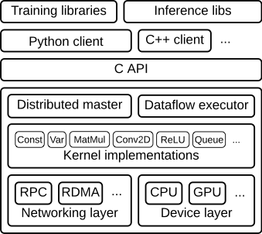
TENSORFLOW ARCHITECTURE :
The TensorFlow runtime is a cross-platform library. Figure 1 illustrates its general architecture.

Slide 7
TENSORFLOW 2.0 V/S TENSORFLOW 1.X:
API Cleanup
Eager Execution
No more globals
Functions, not sessions
Refactor your code into smaller functions
Use Keras layers and models to manage variables
Combine tf.data.Datasets and @tf.function
Advantage of AutoGraph with Python control flow
tf.metrics aggregates data and tf.summary logs them
Use tf.config.experimental_run_functions_eagerly() when debugging

Slide 8
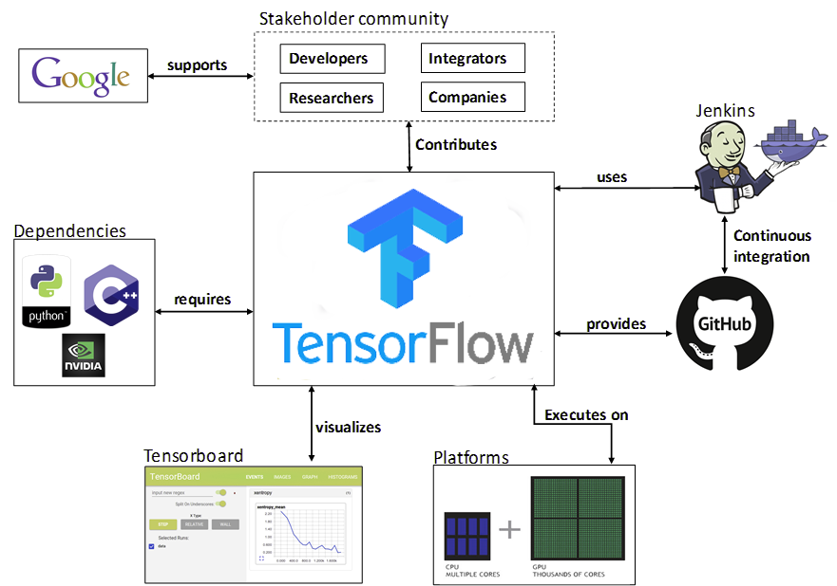
TENSORFLOW ECOSYSTEM :

Slide 9
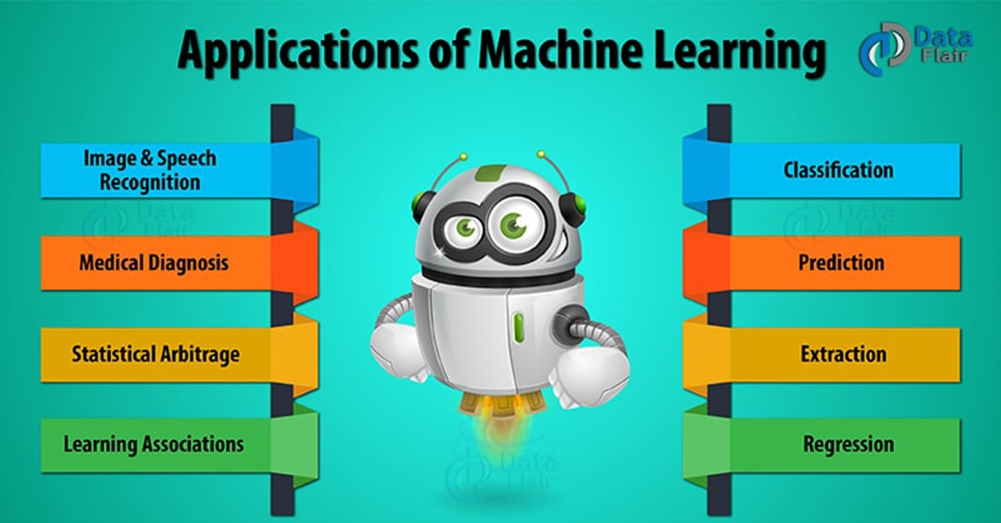
TENSORFLOW APPLICATIONS :
Tensorflow runs on a variety of platforms and the installation is Linux-only and more tedious than CPU-only installation.
The applications go beyond deep learning to support other forms of machine learning like reinforcement learning, which takes you into goal-oriented tasks like winning video games or helping a robot navigate an uneven landscape.
allows you to explore the majority of them including sentiment analysis, google translate, text summarization and the one for which it is quite famous for, image recognition which uses by major companies all over the world, including Airbnb, eBay, Dropbox, Snapchat, Twitter, Uber, for various purposes.

Slide 10
How TensorFlow works :
Nodes and tensors in TensorFlow are Python objects, and TensorFlow applications are themselves Python applications .
The libraries of transformations that are available through TensorFlow are written as high-performance C++ binaries.
Python just directs traffic between the pieces, and provides high-level programming abstractions to hook them together.
TensorFlow applications can be run on most any target that’s convenient: a local machine, a cluster in the cloud, iOS and Android devices, CPUs or GPUs.
If you use Google’s own cloud, you can run TensorFlow on Google’s custom TensorFlow Processing Unit (TPU) silicon for further acceleration.

Slide 11
How TensorFlow works :
The resulting models created by TensorFlow, though, can be deployed on most any device where they will be used to serve predictions.
TensorFlow 2.0, in beta as of June 2019, revamped the framework in many ways based on user feedback, to make it easier to work with and more performant.
Distributed training is easier to run thanks to a new API, and support for TensorFlow Lite makes it possible to deploy models on a greater variety of platforms.
However, code written for earlier versions of TensorFlow must be rewritten—sometimes only slightly, sometimes significantly—to take maximum advantage of new TensorFlow 2.0 features.

Slide 12
TENSORFLOW V/S COMPETITION :
TensorFlow competes with a slew of other machine learning frameworks. PyTorch, CNTK, and MXNet are three major frameworks that address many of the same needs.
1) PyTorch:
In addition to being built with Python, and has many other similarities to TensorFlow:
Hardware-accelerated components under the hood
A highly interactive development model that allows for design-as-you-go work.
A better choice for fast development of projects that need to be up and running in a short time, but TensorFlow wins out for larger projects and more complex workflows.

Slide 13
TENSORFLOW V/S COMPETITION :
2)CNTK :
The Microsoft Cognitive Toolkit
Uses a graph structure to describe dataflow
Focuses most on creating deep learning neural networks.
Handles many neural network jobs faster.
But CNTK isn’t currently as easy to learn or deploy as TensorFlow.

Slide 14
TENSORFLOW V/S COMPETITION :
3) Apache Mxnet :
Adopted by Amazon as the premier deep learning framework on AWS
Can scale almost linearly across multiple GPUs and multiple machines.
-It also supports a broad range of language APIs—Python, C++, Scala, R, JavaScript, Julia, Perl, Go—although its native APIs aren’t as pleasant to work with as TensorFlow’s.

Slide 15

TENSORFLOW :
PROS
CONS
GRAPHS :
has better computational graph visualizations, which are indigenous when compared to other libraries like Torch and Theano
1
MISSING SYMBOLIC LOOPS:
TensorFlow does not offer this feature, but there
is a workaround using finite unfolding
(bucketing).
1
2
NO SUPPORT FOR WINDOWS :
There is still a wide variety of
users who are comfortable with a windows environment rather than a Linux in their systems and TensorFlow does not assuage these users.
LIBRARY MANAGEMENT:
Backed by Google, TensorFlow has the advantage of the seamless performance, quick updates and frequent new releases with new features.
2
DEBUGGING :
lets you execute subparts of a graph which gives it an upper-hand as you can introduce and retrieve discrete data onto an edge
3
3
BENCHMARK TESTS :
TensorFlow lacks behind in both speed and usage
when compared to its competitors
SCALABILITY :
The libraries can be deployed on a gamut of hardware machines, starting from cellular devices to computers with complex setups.
COMPUTATIONAL SPEED :
This is the field where TF is lagging behind but you
focus on the production environment rather
than the performance
4
4

Slide 16
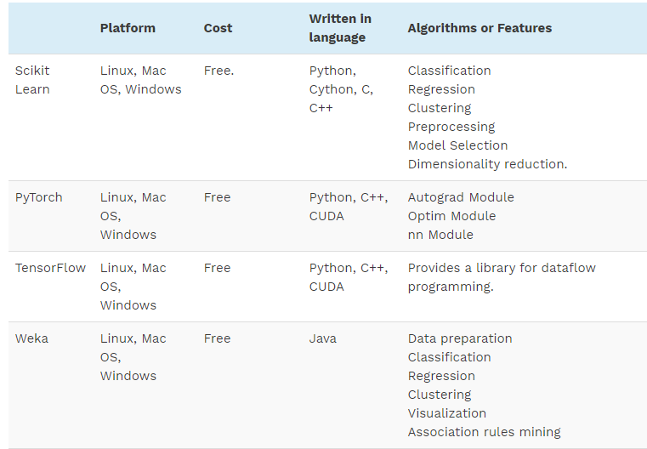
COMPARISON CHART :

Slide 17
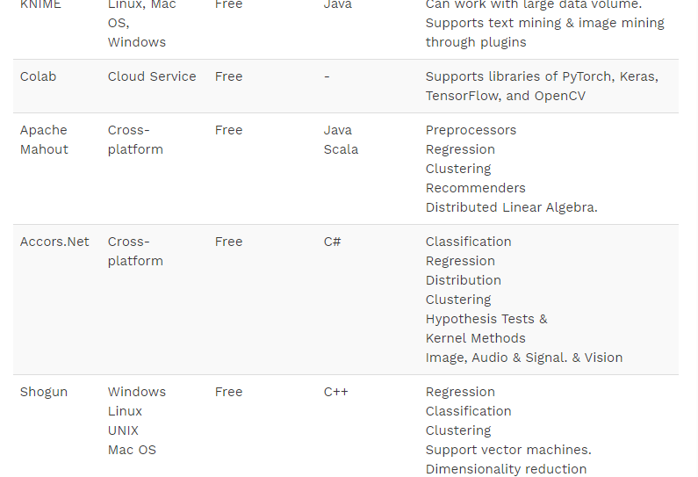
COMPARISON CHART :

Slide 18
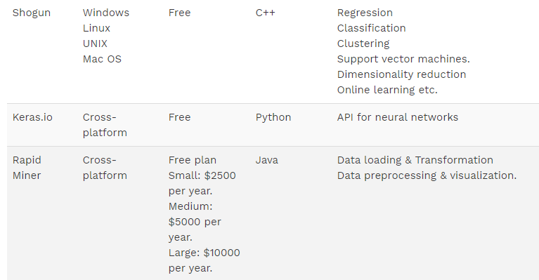
COMPARISON CHART :

Slide 19
INSTALLATION
TensorFlow is compatible with 4 operating Systems :
Windows OS
Ubuntu OS
Mac OS
Raspbian Os

Slide 20
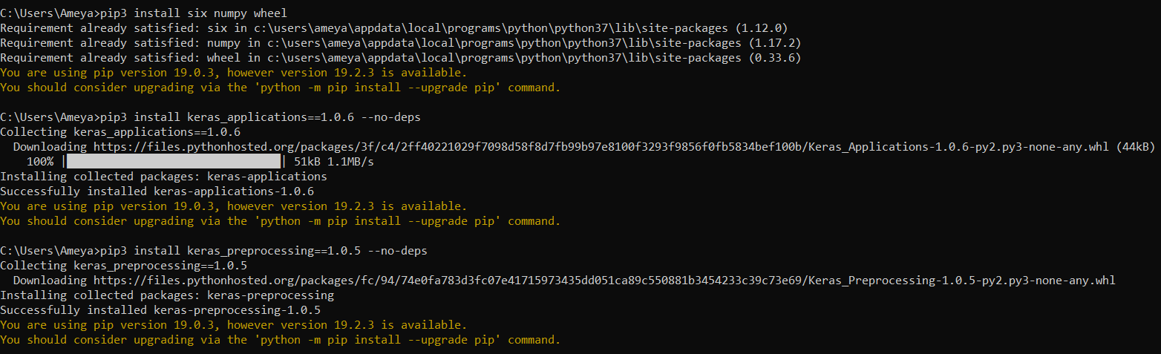
WINDOWS OS :
Install Stable version of Python(python.org/downloads/release/python-374/)
Tick Custom Installation (Preferred) or in Manual Installation ensure “pip” is chosen as the optional feature in the path environmental Variable.
Alternatively you can install PiP Dependencies via Command Prompt.
c:\>pip3 install six numpy wheel
c:\> pip3 install keras_applications==1.0.6 --no-deps
c:\> install keras_preprocessing==1.0.5 --no-deps

Slide 21
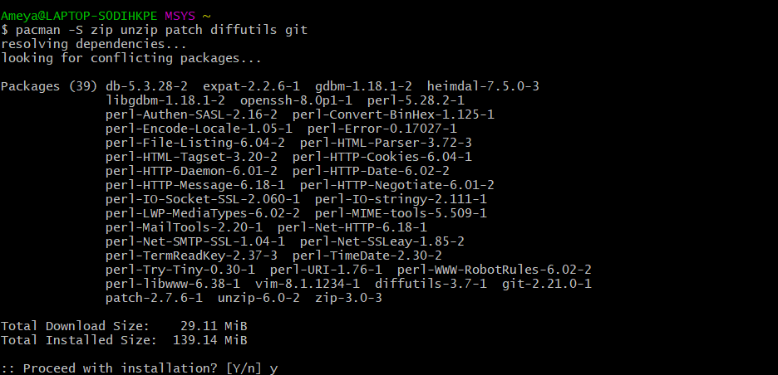
WINDOWS OS
Install Bezel :
1. Specially recommended for 64 Bits Windows 10
2. Install Pre-Requisites :
- Visual C++ Redistributable for Visual Studio 2015
- Msys2 x86_64
3. after Msys2 Installation ,run following command in Msys2 Prompt
-pacman –S zip unzip patch diffutils git

Slide 22
WINDOWS OS
Download Bezel:
bazel build
choose Windows –x86_64.exe file
Setup Bazel to build C++
Install Visual C++ Build Tool 2017 :
- Download Visual Studio 2017
- Download and Install :
a) Microsoft Visual c++ 2017 Redistributable
b) Microsoft Build Tools 2017

Slide 23
WINDOWS OS
Install GPU
- ADDITIONALLY , drivers and software are required to run TensorFlow on a GPU.
Tensorflow Source code
In the command Prompt, type :
- c:\> git clone https://github.com/tensorflow/tensorflow.git
- c:\> cd tensorflow
- git checkout branch_name # r1.9, r1.10, etc. ( r1.15 will be the last 1.x release for tensorflow.It will be followed by patches and small updates)

Slide 24
WINDOWS OS
Configure the Build
-Configure the build of your system by running the following code at the source of your TensorFlow
C:\>python ./configure.py
Build PiP Package
- For CPU :
Need bazel to make tensorflow package builder for CPU-only support.
C:\>bazel build --config=opt //tensorflow/tools/pip_package:build_pip_package
- For GPU :
Tensorflow PiP packages will by include GPU support. It will work on machines with and without Nvidia Gpu’s.

Slide 25
WINDOWS OS
Build the Package
- Bazel build is a command that creates an executable command- build_pip_package
c:\> bazel-bin\tensorflow\tools\pip_package\build_pip_package C:/tmp/tensorflow_pkg
Install the Package
-Depending on the tensorflow version and platform,a filename with the extension .whl is generated.
-Use the pip3 install command to install the package.
c:\> pip3 install C:/tmp/tensorflow_pkg/tensorflow-version-cp36-cp36m-win_amd64.whl

Slide 26
UBUNTU OS:
In the command Terminal type :
$ sudo apt install python-dev python-pip # or python3-dev python3-pip
-As for the Windows Os,we need to install TensorFlow PiP package dependencies. For people with virtual environment omit the --user argument in the code.
- $ pip install -U --user pip six numpy wheel setuptools mock 'future>=0.17.1’
- $ pip install -U --user keras_applications==1.0.6 --no-deps
- $ pip install -U --user keras_preprocessing==1.0.5 --no-deps
Download tensorflow Source code
- $ git clone https://github.com/tensorflow/tensorflow.git
- $ cd tensorflow
To configure the build
- $ ./configure

Slide 27
UBUNTU OS:
GPU Support
In order to have a GPU support, we need to set CUDA=‘Y’, during the configuration and then specify the exact version of CUDA.
If any one system has different versions of CUDA and CUDANN installed, better set the version instead of relying on default.
Build the PiP Package
1. Installing Bazel :
Bazel is supported over 2 platforms
- 18.04(LTS)
- 16.04(LTS)

Slide 28
UBUNTU OS:
Using Required Packages:
$ sudo apt-get install pkg-config zip g++ zlib1g-dev unzip python3 #Pre-requisities
2. Download Bazel
Same as Windows, we need to download Bazel binary installer name bazel-<vesion>-installer-linux-x86_64.sh from
bazel build.
3. Run the installer Package
Run the following command
chmod +x bazel-<version>-installer-linux-x86_64.sh
./bazel-<version>-installer-linux-x86_64.sh --user

Slide 29
UBUNTU OS:
4. Add Bazel to Environmental Path Variable
It’s a good practice to add it to your default path as well.
export PATH= “$PATH : $HOME/git”
5. Using Bazel’s APT repository
We can build JAVA code using Bazel, by installing a JDK
$ sudo apt-get install open jdk-8-jdk #16.04(LTS)
$ sudo apt-get install open jdk-11-jdk # 18.04(LTS)
6. Add bazel distribution URI as a package source
echo "deb [arch=amd64] https://storage.googleapis.com/bazel-apt stable jdk1.8" | sudo tee /etc/apt/sources.list.d/bazel.list
sudo apt-get install curl
curl https://bazel.build/bazel-release.pub.gpg | sudo apt-key add -

Slide 30

UBUNTU OS:
7. Install and update Bazel
$ sudo apt-get update && sudo apt-get install bazel #install
$ sudo apt-get install --only-upgrade bazel #update
Bazel Build for TensorFlow Packages
$ bazel build //tensorflow/tools/pip_package:build_pip_package
CPU Only Support
We can use Bazel to make the tensorflow package builder with only CPU support.
$ bazel build --config=opt //tensorflow/tools/pip_package:build_pip_package

Slide 31
UBUNTU OS:
GPU support :
bazel build --config=opt --config=cuda //tensorflow/tools/pip_package:build_pip_package
Build Package:
The Bazel command which we used previously created and executable file names build-pip-pack. This program helps building the PiP package.
From Release branch:
- $ ./bazel-bin/tensorflow/tools/pip_package/build_pip_package /tmp/tensorflow_pkg
From Master Branch:
- $ ./bazel-bin/tensorflow/tools/pip_package/build_pip_package --nightly_flag /tmp/tensorflow_pkg
Install Package:
- $ pip install /tmp/tensorflow_pkg/tensorflow-version-tags.whl

Slide 32
UBUNTU OS:
Tensorflow PiP dependencies :
$ pip install -U --user pip six numpy wheel setuptools mock 'future>=0.17.1’
$ pip install -U --user keras_applications==1.0.6 --no-deps
$ pip install -U --user keras_preprocessing==1.0.5 --no-deps

Slide 33
MAC OS
HomeBrew :
It installs files and packages that does not come pre-installed in Mac Os.
We can create our own homebrew packages .
It tells everything we are going to do before we hit confirmation.
On the Mac Os command Prompt, type
$ /usr/bin/ruby -e "$(curl -fsSL https://raw.githubusercontent.com/Homebrew/install/master/install)“
$ export PATH="/usr/local/bin:/usr/local/sbin:$PATH“
$ brew install python@2 # or python (Python 3)

Slide 34
MAC OS
Install Bazel:
Install Xcode Command :
download Xcode from Apple Developer Website
On installing Xcode, we can accept the license agreement for all users.
sudo Xcodebuild -license accept
Bazel Installer :
Download Bazel binary installer with the file name bazel-<version>-installer-Darwin-x86_64.sh
Run Installer :
chmod +x bazel-<version>-installer-darwin-x86_64.sh
./bazel-<version>-installer-darwin-x86_64.sh --user
user flag installs bazel to your $home/bin directory

Slide 35
MAC OS
To add Bazel directory to your home path.
export PATH="$PATH:$HOME/bin“
USING Homebrew
Install Homebrew /usr/bin/ruby -e "$(curl -fsSL \https://raw.githubusercontent.com/Homebrew/install/master/install)“
Install Bazel Homebrew Package
brew tap bazelbuild/tap
brew install bazelbuild/tap/bazel

Slide 36
MAC OS
user flag installs bazel to your $home/bin directory
To add Bazel directory to your home path.
export PATH="$PATH:$HOME/bin“
USING Homebrew
Install Homebrew
/usr/bin/ruby -e "$(curl -fsSL \https://raw.githubusercontent.com/Homebrew/install/master/install)“
Install Bazel Homebrew Package
brew tap bazelbuild/tap
brew install bazelbuild/tap/bazel

Slide 37
MAC OS
Upgrade Bazel
brew upgrade bazelbuild/tap/bazel
No Gpu support for Mac Os
Download Tensorflow Source code
git clone https://github.com/tensorflow/tensorflow.git
cd tensorflow

Slide 38
MAC OS
Build Configuration
$ ./configure
Build PiP Package
$ bazel build //tensorflow/tools/pip_package:build_pip_package
Tensorflow 1.x:
To build the 1.x version of tensorflow from master,we have to use bazel build to create tensorflow 1.x package.
$ bazel build --config=v1 //tensorflow/tools/pip_package:build_pip_package
Cpu-only Support :
$ bazel build --config=opt //tensorflow/tools/pip_package:build_pip_package

Slide 39
MAC OS
Build PiP Package:
The bazel build command creates an executable named build_pip_package—this is the program that builds the pip package :
$ ./bazel-bin/tensorflow/tools/pip_package/build_pip_package /tmp/tensorflow_pkg #release branch
$ ./bazel-bin/tensorflow/tools/pip_package/build_pip_package --nightly_flag /tmp/tensorflow_pkg #master branch
Install the Package:
$ pip install /tmp/tensorflow_pkg/tensorflow-version-tags.whl

Slide 40

INSTALLATION OF LATEST VERSION OF TENSORFLOW IN MAC OS

Slide 41
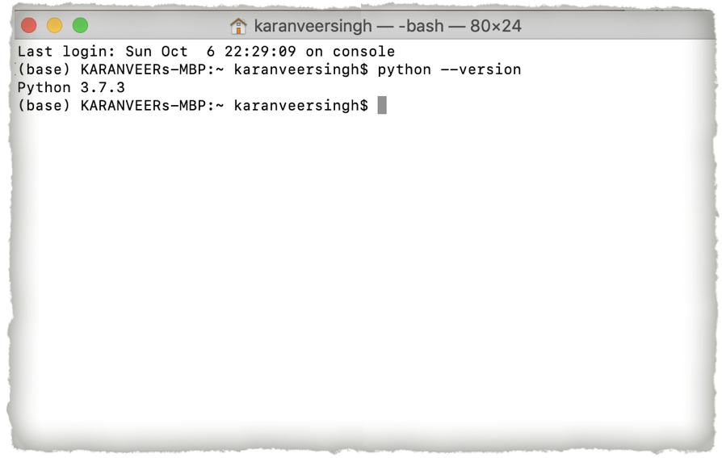
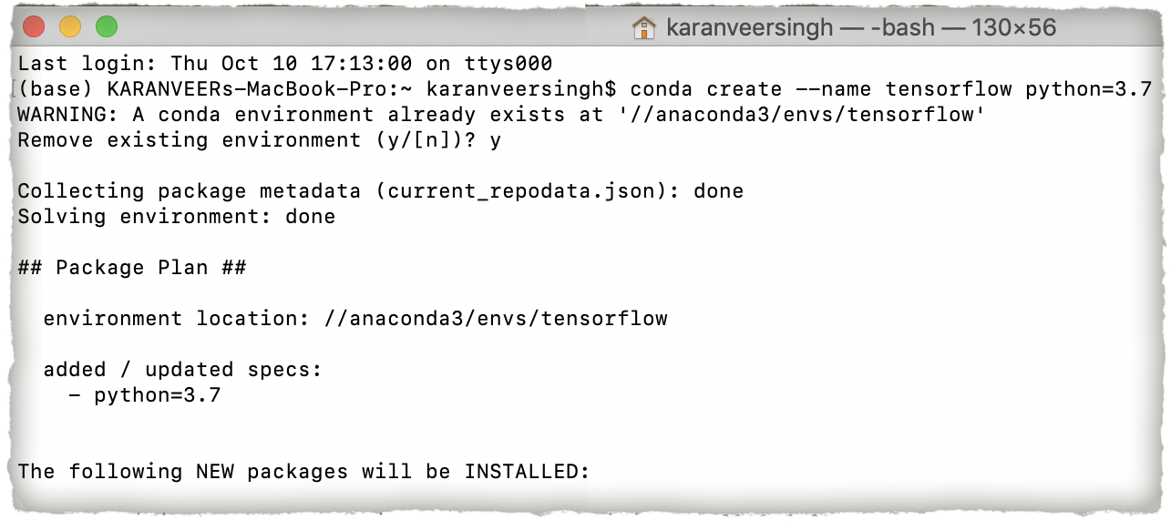
INSTALLATION OF LATEST VERSION OF TENSORFLOW IN MAC OS
Version of Python in Macbook
After Installing Anaconda
Creating virtual Environment

Slide 42
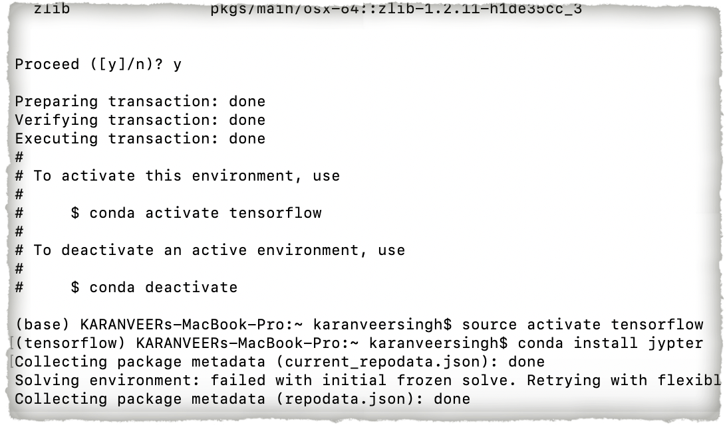
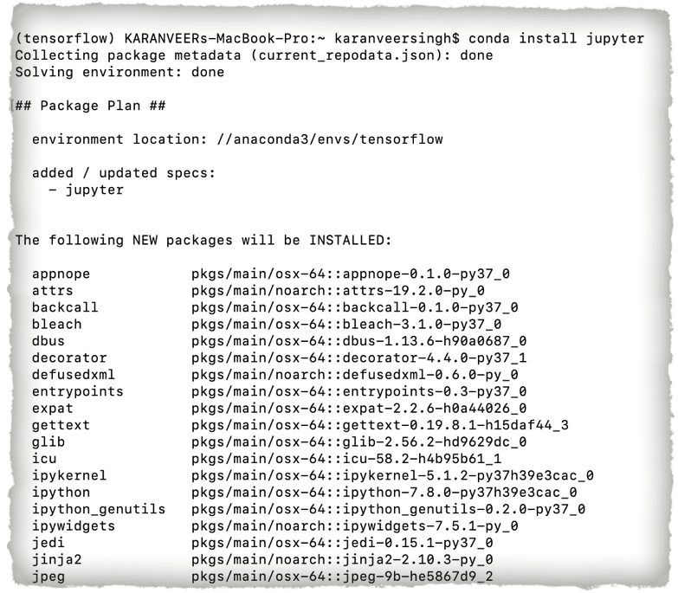
INSTALLATION OF LATEST VERSION OF TENSORFLOW IN MAC OS
Virtual Environment created.
Installing Jupyter with the new virtual environment.

Slide 43
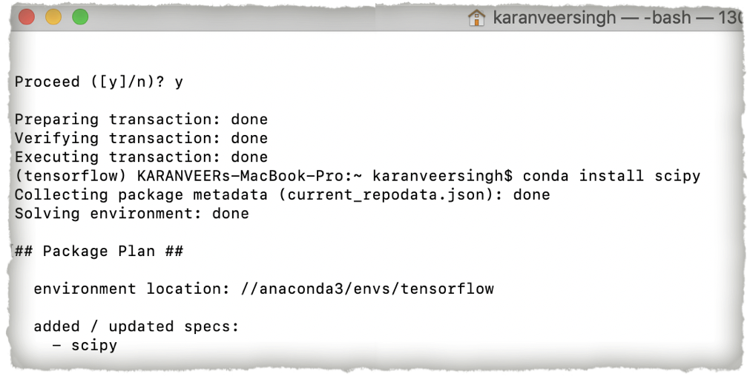
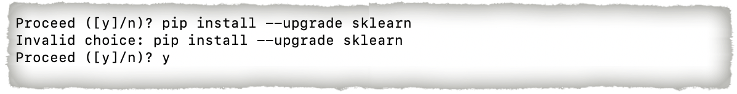
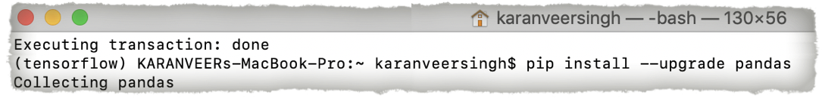
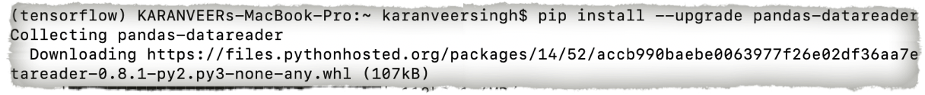
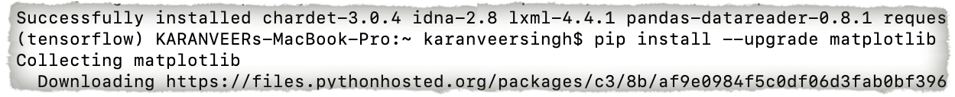

INSTALLATION OF LATEST VERSION OF TENSORFLOW IN MAC OS
Installing
Scipy
sklearn
Pandas
pandas-datareader
matplotlib

Slide 44
INSTALLATION OF LATEST VERSION OF TENSORFLOW IN MAC OS
Installing
Pillow
Requests
h5py
Psutil

Slide 45
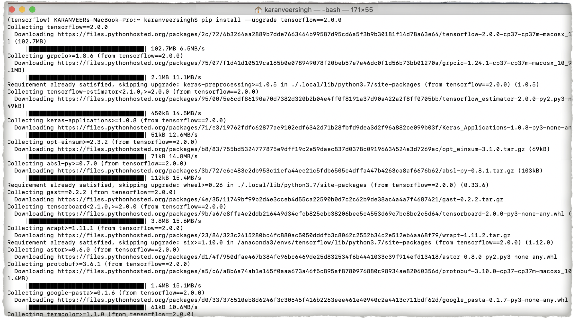
INSTALLING TENSORFLOW VERSION 2.0.0

Slide 46
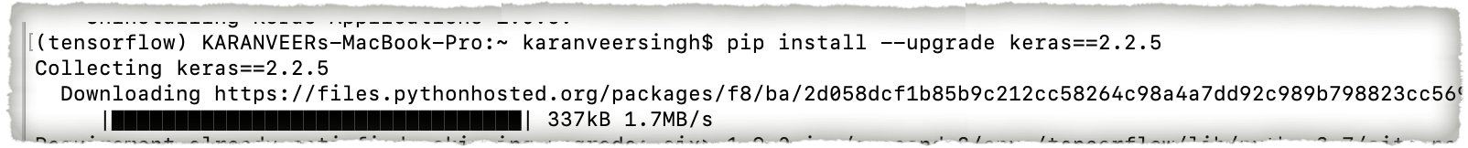
INSTALLING KERAS :
Keras is merged and comes with Anaconda nowadays.
Installed latest version 2.2.5

Slide 47
PROBLEMS FACES WHILE INSTALLING TENSORFLOW ON MAC OS :
Python 2.7 version inbuilt with the Mac OS.
Python version updated to 3.7.3 after installing the Anaconda.
Tensorflow supports Python version 3.6 but last month updated with python 3.7 for Tensorflow 2.0.0 version and references not available.
Still not compatible with python 3.7.3 version

Slide 48
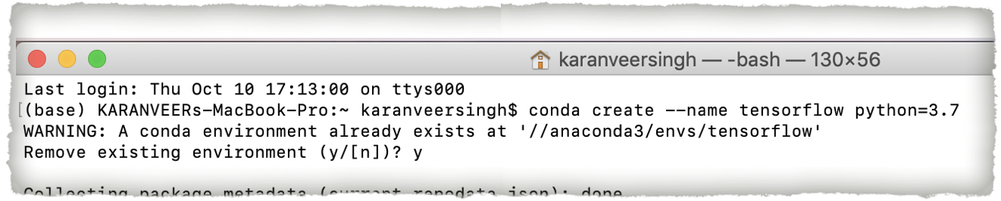
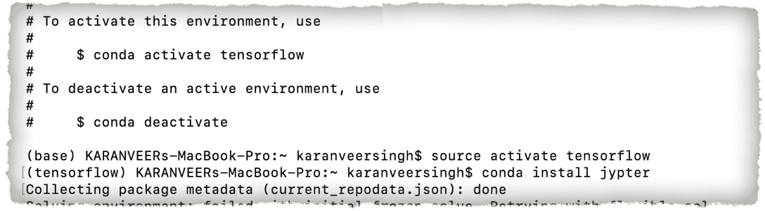
SOLUTION :
Creating a virtual environment with a keyword of Tensorflow with Python 3.7 for Tensorflow 2.0.0 version.
Downloading all the packages and libraries .
Activating the the Virtual Tensorflow environment

Slide 49
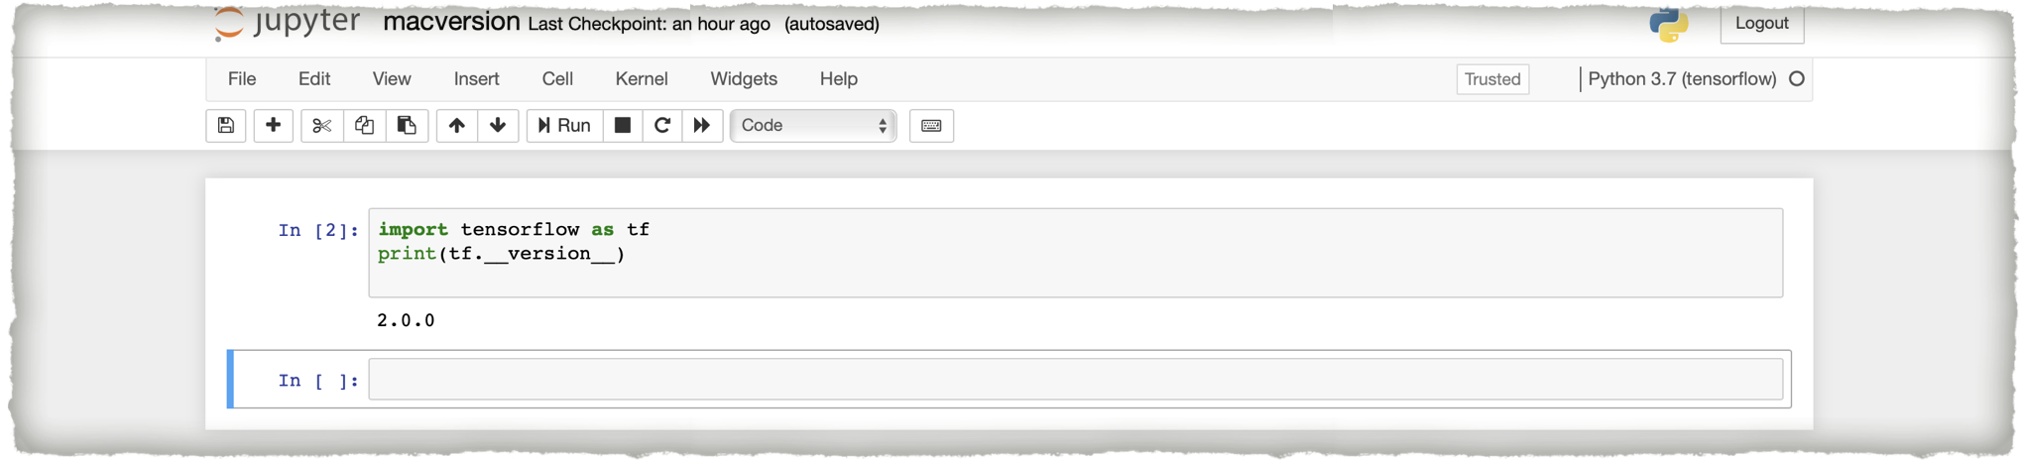
SOLUTION :
Tensorflow Mac version 2.0.0 with 3.7
Python version on localhost 8888

Slide 50
RASPBIAN OS :
Install Docker :
It is a platform used by developers to develop,deploy, and run applications with containers.
To simplify dependency management, the build script uses Docker.
Will help us in creating a virtual Linux development environment.
Tensorflow Source code:
$ git clone https://github.com/tensorflow/tensorflow.git
$ cd tensorflow
Like in all other Operating systems, in Rasp Os also a .whl file is created. Copy it to the raspberry Pi and install with PiP.
$ pip install tensorflow-version-cp34-none-linux_armv7l.whl

Slide 51
RASPBIAN OS
The repository defaults to Master build. For release branch build
$ git checkout branch_name # r1.9, r1.10, etc.
Build From Source :
Cross-compile the TensorFlow source code to build a Python pip package with ARMv7 NEON instructions that works on Raspberry Pi 2 and 3 devices.
$ CI_DOCKER_EXTRA_PARAMS="-e CI_BUILD_PYTHON=python3 -e CROSSTOOL_PYTHON_INCLUDE_PATH=/usr/include/python3.4" \tensorflow/tools/ci_build/ci_build.sh PI- PYTHON3 \tensorflow/tools/ci_build/pi/build_raspberry_pi.sh #Python 3.0
$ tensorflow/tools/ci_build/ci_build.sh PI \tensorflow/tools/ci_build/pi/build_raspberry_pi.sh #Python 2.7

Slide 52
JUPYTER NOTEBOOK:
Non Profit, open source project.
Supports Data Science and Scientific Computing across all programming languages.
As all open software,Jupyter is also developed by the Jupyter community on GitHub.
Python language could easily be availed to write a machine learning code on Jupyter since it already comes with a pre configured data science environment as it runs on the cloud or on our own hardware.

Slide 53
JUPYTER HUB :
Without asking the users for installation or any other tasks ,serves access to users for computational environment and resources.
Everyone, students researchers and scientists alike get their own workspace which can be easily modified by the system administrators.
------Installation------
Can be installed using CONDA or PiP.
conda install -c conda-forge jupyterlab #CONDA
pip install jupyterlab #PiP

Slide 54
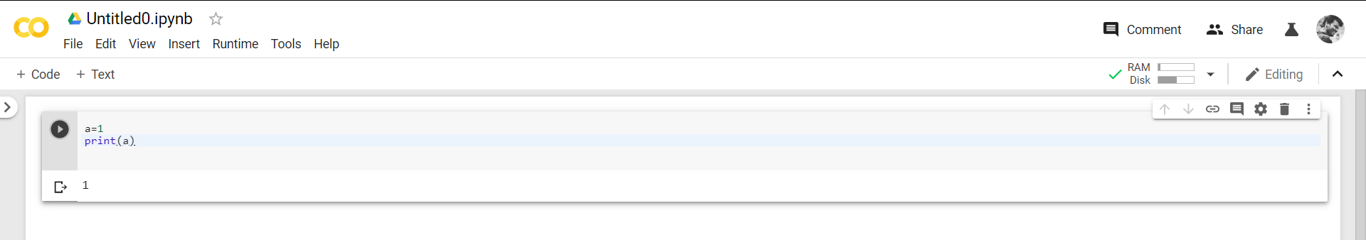

GOOGLE COLAB:
Previously we learnt about installing Jupyter in our hardware, Google Colab gives us access to Jupyter Notebook on our browser itself.
Runs entirely on the cloud. No need for installation!
It’s easy and efficient for systems which do not have a lot of memory space.
We can easily write a python code on it and run the shell script via the play button on the left of the code.

Slide 55
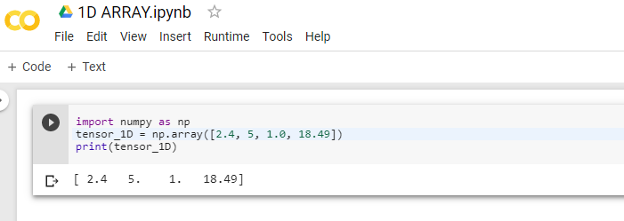
BASIC CODE EXAMPLES :
EXAMPLE 1: CREATING A ONE DIMENSIONAL ARRAY
One dimensional tensor - normal array structure which has one set of values of the same data type.
>>>import numpy as np
>>> tensor_1D = np.array([2.4, 5, 1.0, 18.49])
>>> print (tensor_1D)

Slide 56
BASIC CODE EXAMPLES :
>>>print tensor_1d[0]
2.4
>>>print tensor_1d[2]
1
EXAMPLE 2 : CREATING A TWO DIMENSIONAL ARRAY :
Two dimensional Tensors Sequence of arrays are used for creating “two dimensional tensors”.
>>>import numpy as np
>>> tensor_2d=np.array([(1,2,3,4),(4,5,6,7),(8,9,10,11),(12,13,14,15)])
>>> print(tensor_2d)
[[ 1 2 3 4]
[ 4 5 6 7]
[ 8 9 10 11]
[12 13 14 15]]

Slide 57
BASIC CODE EXAMPLES :
EXAMPLE 3 : CREATING MULTIDIMENSIONAL ARRAY
import tensorflow as tf
import numpy as np
m1 = np.array([(3,3,3),(3,3,3),(3,3,3)],dtype='int32')
m2 = np.array([(2,2,2),(2,2,2),(2,2,2)],dtype='int32')
print (m1)
print (m2)
m1 = tf.constant(m1)
m2 = tf.constant(m2)
m_product = tf.matmul(m1, m2)
m_sum = tf.add(m1,m2)

Slide 58
BASIC CODE EXAMPLES :
m_3 = np.array([(4,5,6),(3,4,1),(2,0,1)],dtype='float32')
print (m_3)
m_det = tf.matrix_determinant(m_3)
with tf.Session() as sess:
result1 = sess.run(m_product)
result2 = sess.run(m_sum)
result3 = sess.run(m_det)
print (result1)
print (result2)
print (result3)

Slide 59
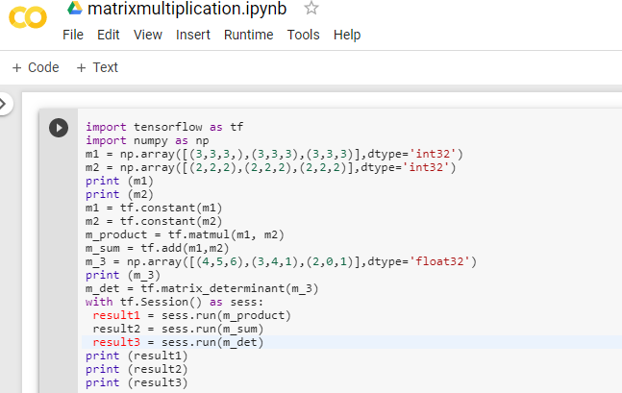
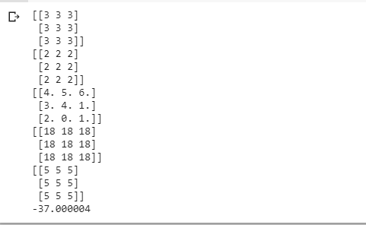
BASIC CODE EXAMPLES :

Slide 60
BASIC CODE EXAMPLES :
EXAMPLE 4 : MATRIX ADDITION :
import tensorflow as tf
c = tf.Variable([[4,5], [7,1]], name="matrix_c")
d = tf.Variable([[6,8], [5,2]], name="matrix_d")
init = tf.variables_initializer([c, d], name="init")
p = tf.add(c, d)
with tf.Session() as s:
writer = tf.summary.FileWriter('graphs', s.graph)
s.run(init)
print(s.run(p))
writer.close()

Slide 61
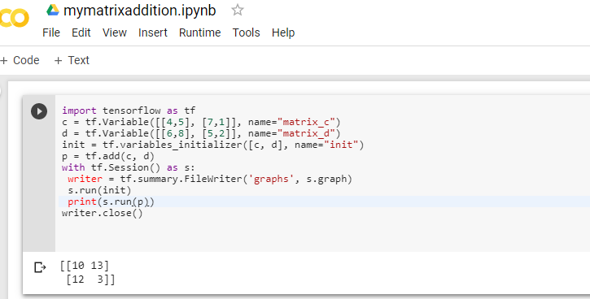
BASIC CODE EXAMPLES :

Slide 62
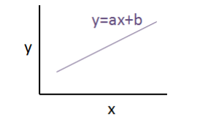
BASIC CODE EXAMPLES :
EXAMPLE 5 : LINEAR REGRESSION
focusing on the main example of linear regression implementation using TensorFlow.
Logistic regression or linear regression is a supervised machine learning approach for the classification of order discrete categories.
If y is the dependent variable & x is considered as the independent variable, then the linear regression relationship of two variables will look like the following equation:
Y = ex + f
e : value of e is the slope
F : value of f is the y- intercept

Slide 63
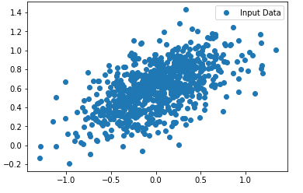
BASIC CODE EXAMPLES :
EXAMPLE 5 : LINEAR REGRESSION
import numpy as np import the Python library NumPy and Matplotlib.
import matplotlib.pyplot as plt
number_of_points = 800
xaxis_point = [ ]
yaxis_point = [ ] Define the number of coefficients necessary for logistic regression.
e = 0.36
f = 0.59
for i in range(number_of_points):
x = np.random.normal(0.0,0.4)
y = e*x + f +np.random.normal(0.0,0.2)
xaxis_point.append([x])
yaxis_point.append([y])
plt.plot(xaxis_point,yaxis_point, 'o', label='Input Data')
plt.legend()
plt.show()
Iterate the variables for generating random points around the regression equation
View the generated points using Matplotlib

Slide 64
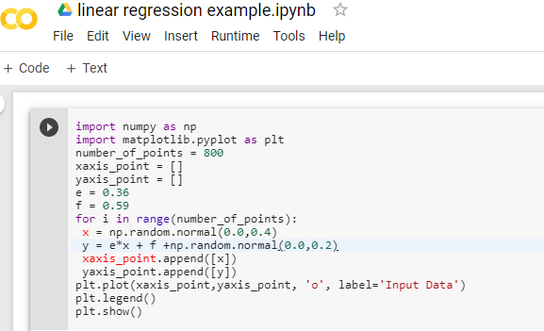
BASIC CODE EXAMPLES :

Slide 65

TENSORFLOW CASE STUDIES

Slide 66
TENSORFLOW CASE STUDIES :
Lets have a quick look :
Who started using TensorFlow and Why?
what are the different companies that are working with TensorFlow?
How did they get benefited from it?

Slide 67
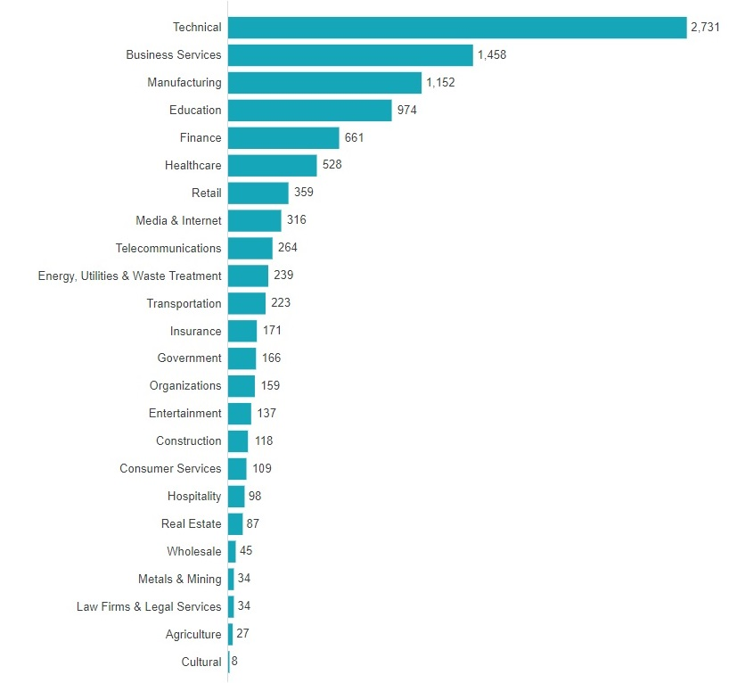
COMPANIES USING TENSORFLOW :
There are diverse alphabet companies being benefited with TensorFlow. In which we can visualize this software creating quite a stir in various fields too.

Slide 68
THE FOUR DIFFERENT COMPANIES THAT BENIFITED FROM TENSORFLOW:
TensorFlow being an open sourcing, it is Impossible to talk about every company that is using this software.
Let us see the four different companies where TensorFlow played a major role in the development of their business.
The companies are:
Airbnb
GE HealthCare
Airbus
Qualcomm

Slide 69

THE FOUR DIFFERENT COMPANIES THAT BENIFITED FROM TENSORFLOW:
1)
Initially the team used to sort the images manually which consumed lots of time and energy. A smarter way to over come such issues was to shift towards a better technology.
With TensorFlow the efficiency of their business was rapidly growing and this in turn gave the company a smoother experience and better results.
Following factors could be visualized of have a steady improvement in the software.
Speeding up the search process.

Slide 70
THE FOUR DIFFERENT COMPANIES THAT BENIFITED FROM TENSORFLOW:
Prediction based on previous search, cost estimation
Discovering and classifying in-app message intent at Airbnb
Use of sequence models and LSTM networks to create suggested responses for our customer service agents .
Learning Market dynamics for optimal pricing .
Contextual Calendar Reminders .

Slide 71

THE FOUR DIFFERENT COMPANIES THAT BENIFITED FROM TENSORFLOW:
2)
The scan operators requires low resolution images to identify the specific location.
This procedure was complicated as the orientation, location, and coverage needs to be correct in all three spatial dimensions.
It is time-consuming and difficult, especially for complex anatomies.

Slide 72
THE FOUR DIFFERENT COMPANIES THAT BENIFITED FROM TENSORFLOW:
With TensorFlow in picture the company benefited :
Support for 2D and 3D Cascaded Neural Networks (CNN) which is the primary requirement for medical image volume processing.
Continuous development with backward compatibility making it easier for code development and maintenance
Stability of graph computations made it attractive for product deployment
Extensive open-source user and developer community which supported latest algorithm implementations and made them readily available
Keras interface was available which significantly reduced the development time

Slide 73
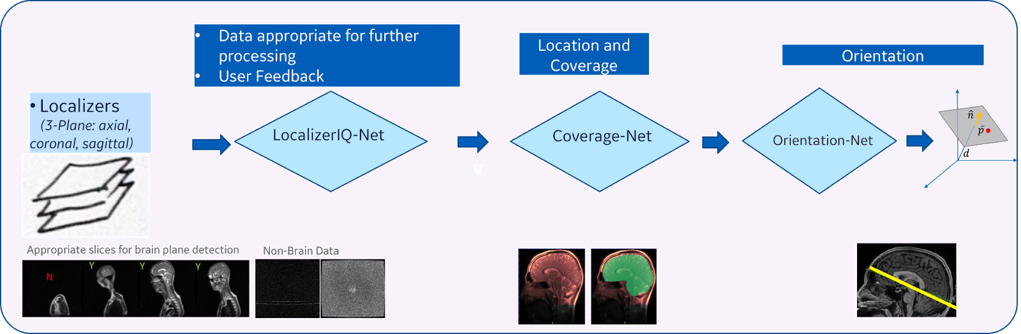
The images that are taken now are with a better clarity so as for the team to identify the specific location for diagnosis.
This Company is working wonders already in the section of brain. They are looking forward to expand themselves further more to knee and spine as well.
Deployment was done using a TensorFlow Serving CPU based docker container and RestAPI calls to process the localizer once it is acquired.
In short this company has used TensorFlow for Intelligent Scanning Using Deep Learning for MRI

Slide 74

THE FOUR DIFFERENT COMPANIES THAT BENIFITED FROM TENSORFLOW:
3)
Airbus Defence and Space uses an algorithm to identify satellite images which is sometimes very difficult to determine, even for the human eye, whether a particular area on a satellite image is cloud or snow.
But it has an error rate of 11%, which has prompted Airbus to test the deep-learning platform TensorFlow.
TensorFlow analyses a large number of images, looks for recurring patterns, and uses this to learn how to identify objects by itself.
In the TensorFlow test phase, the error rate has already improved to just 3%.
Airbus is convinced that these new applications will make a huge difference and now that these programs are freely available, the field of image recognition will progress in leaps and bounds and open up new opportunities for Airbus.

Slide 75

THE FOUR DIFFERENT COMPANIES THAT BENIFITED FROM TENSORFLOW:
4)
TensorFlow was designed to run on processing units inside of processors.
Snapdragon processors integrate a CPU, GPU and many more technologies including a Digital Signal Processor, or DSP.
The companies DSP architecture is designed to process certain audio and video features more quickly and at lower power than a CPU or GPU, which is why it’s ideal to exploit its advantages.
The chart below illustrates the benefits of apps optimized for our DSP

Slide 76
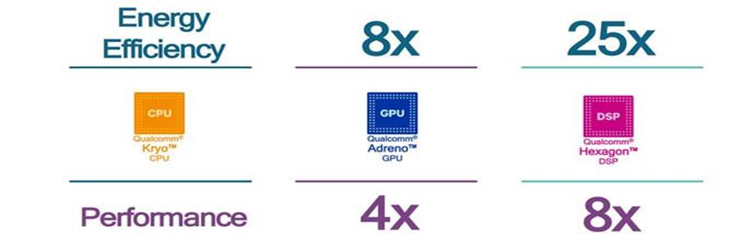
THE FOUR DIFFERENT COMPANIES THAT BENIFITED FROM TENSORFLOW:
TensorFlow will run on the DSP so apps can run faster and more efficiently without taxing the entire system.
Qualcomm Technologies also offers support for TensorFlow on Snapdragon processors via the Qualcomm Snapdragon Neural Processing Engine SDK, a heterogeneous software framework engineered to allow OEMs to run TensorFlow-trained models on the core (CPU, GPU, or DSP) that can deliver the best performance and power profile for the intended user experience.

Slide 77
REFRENCES:
https://www.tensorflow.org/install
https://www.udemy.com/tutorial/complete-guide-to-tensorflow-for-deep-learning-with-python/installing-tensorflow-environment/
https://github.com/tensorflow/docs/blob/master/site/en/r1/guide/extend/architecture.md
https://www.tensorflow.org/guide/effective_tf2
https://www.tensorflow.org/guide/keras/overview
https://machinelearningmastery.com/introduction-python-deep-learning-library-tensorflow/
https://hub.packtpub.com/tensorflow-always-tops-machine-learning-artificial-intelligence-tool-surveys/
https://medium.com/tensorflow/intelligent-scanning-using-deep-learning-for-mri-36dd620882c4
https://github.com/aymericdamien/TensorFlow-Examples/blob/master/examples/1_Introduction/basic_operations.py
https://www.infoworld.com/article/3278008/what-is-tensorflow-the-machine-learning-library-explained.html

